Slide 1

How to use Helloblock
Yahboom
Yahboom OMIBOX Tutorial

Slide 2
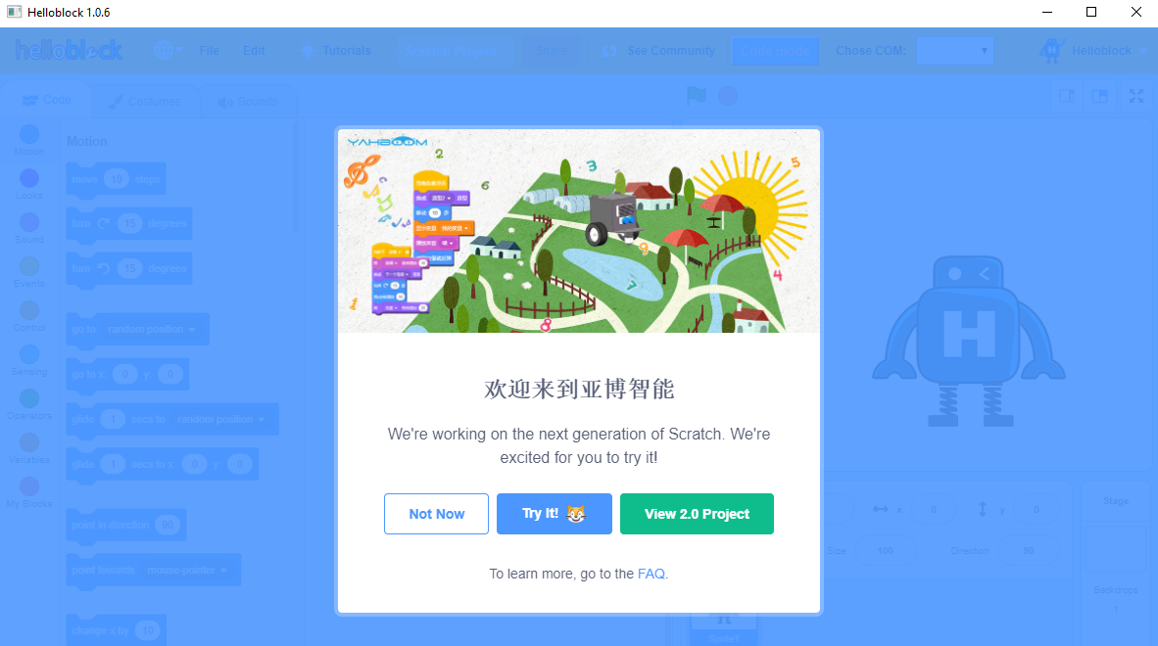
1.Double-click the shortcut on the desktop to enter the interface as shown below.
Yahboom OMIBOX Tutorial

Slide 3
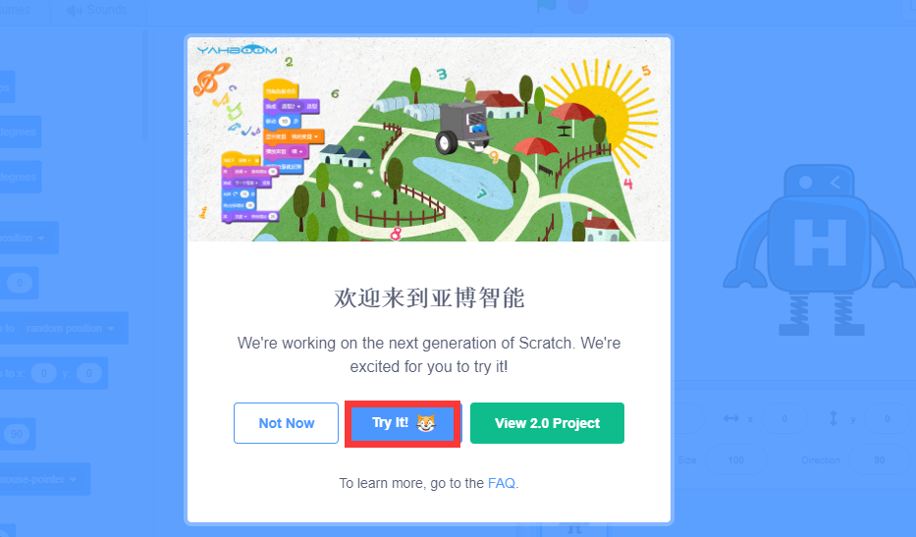

2.Click 【Try It】to enter programming interface, as shown below.
Come join us for a fun programming .
Yahboom OMIBOX Tutorial

Slide 4
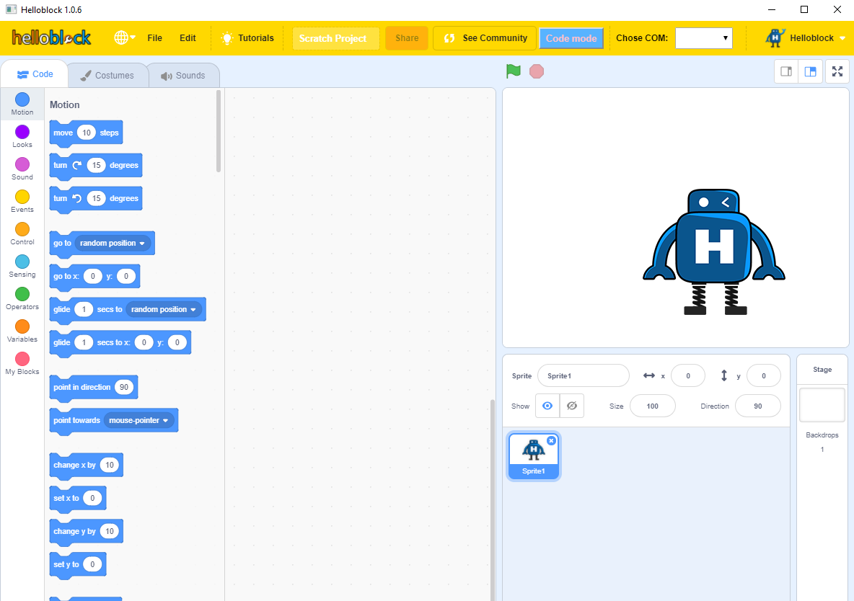
3.The interface shown below is Helloblock graphical programming interface.
Yahboom OMIBOX Tutorial

Slide 5
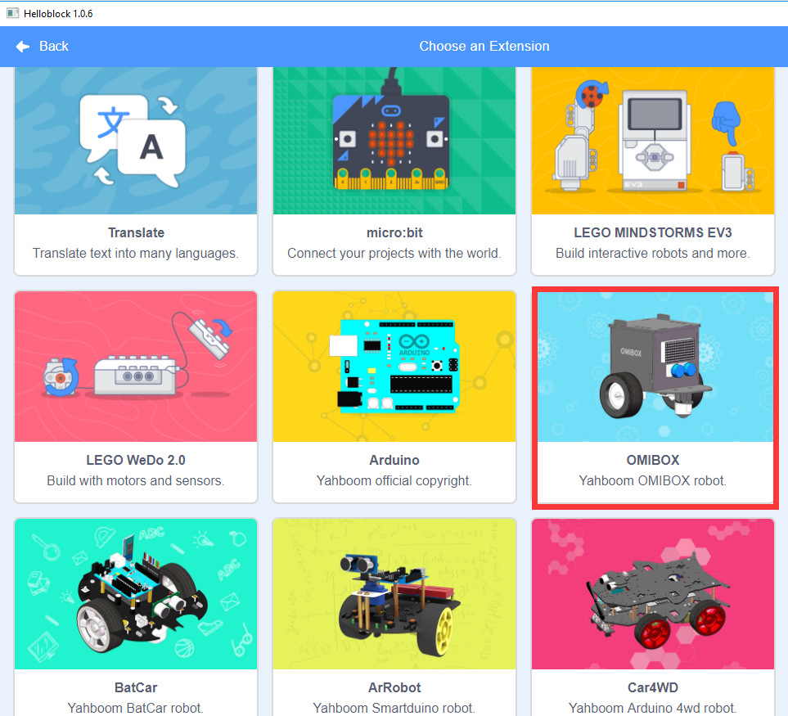
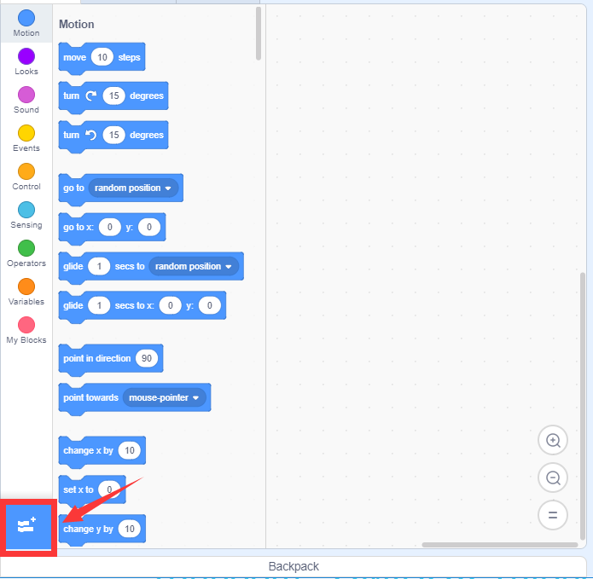
4. Click on the place shown on the left below to add the expansion pack for the OmiBox robot.
Yahboom OMIBOX Tutorial

Slide 6
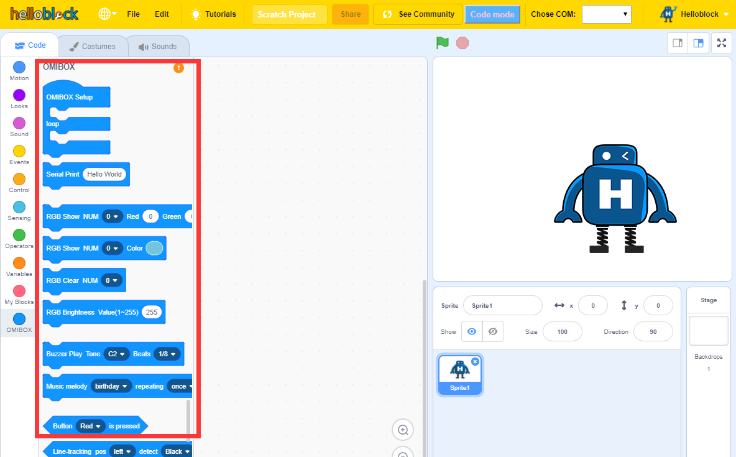
5. After the addition is completed, OmiBox building block expansion package will be added on the left side of the programming interface, as shown in the following figure.
Yahboom OMIBOX Tutorial

Slide 7
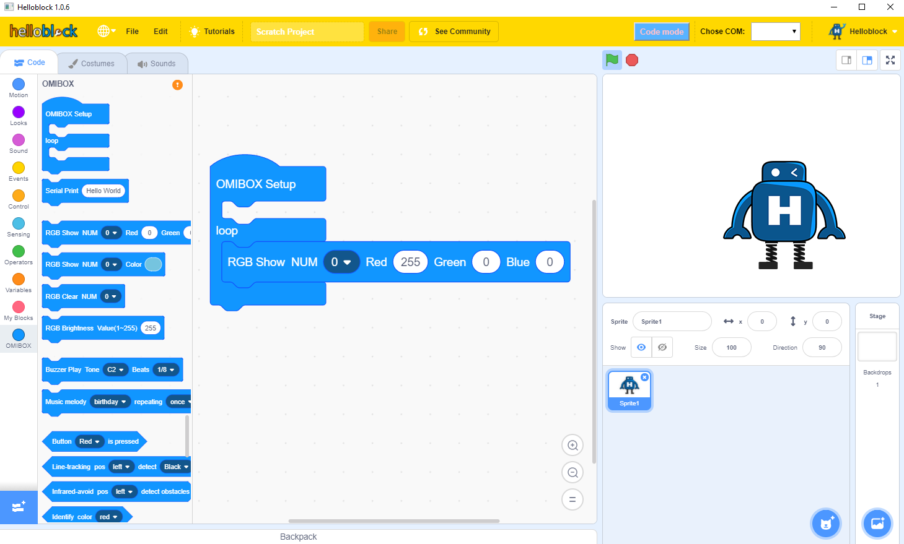
6.We can drag the building block to the programming area and start writing the program, as shown below.
Yahboom OMIBOX Tutorial

Slide 8
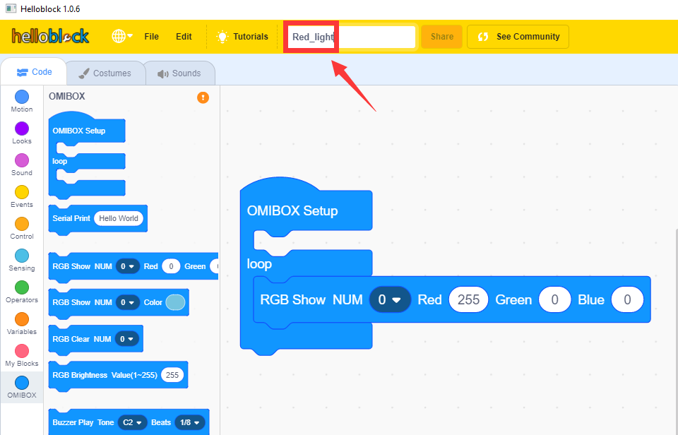
7.We can give a name to the program we wrote in the location shown below. (for example: Red_light)
Yahboom OMIBOX Tutorial

Slide 9
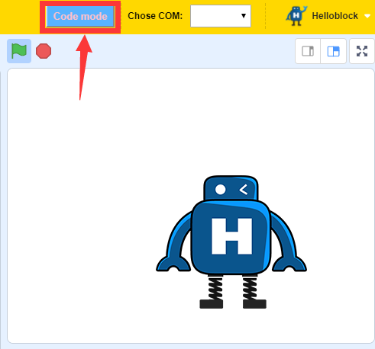
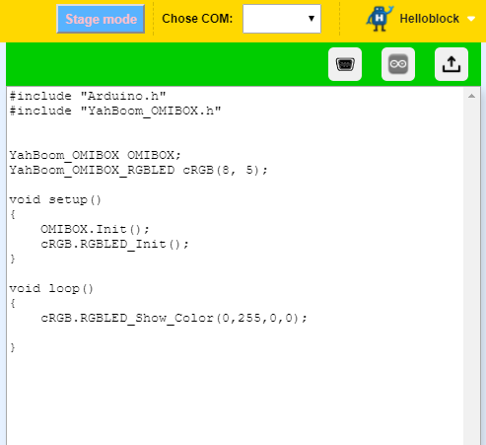
8.After the program is written, click on the blue icon in the upper right corner of the programming interface to switch to 【Code Mode】, as shown below.
Yahboom OMIBOX Tutorial

Slide 10
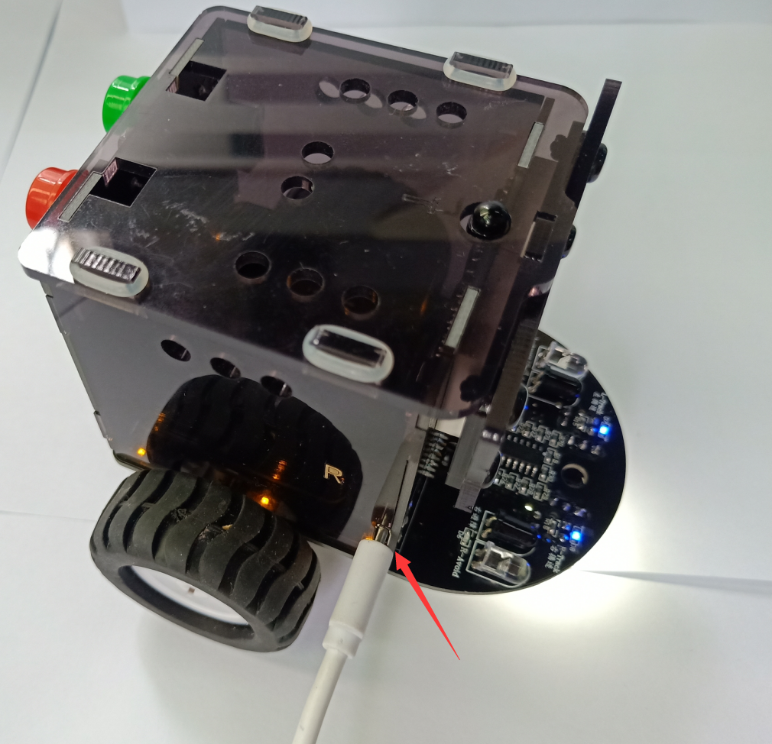
9.Connect the OMIBOX robot to the computer with a USB cable.
!!!Note:you must turn on the power switch of the OmiBox robot.
Yahboom OMIBOX Tutorial

Slide 11
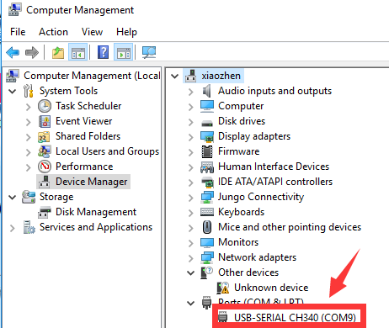
10.Then, open the computer device manager and you will recognize the corresponding CH340 port, as shown below:
Note: The port number of each computer will be different, as long as it recognizes that CH340 is the port we need.
Before this step, please refer to the "Installation of CH340 Driver" file to complete the installation of the CH340 driver. Otherwise, the port will not be recognized.
Yahboom OMIBOX Tutorial

Slide 12
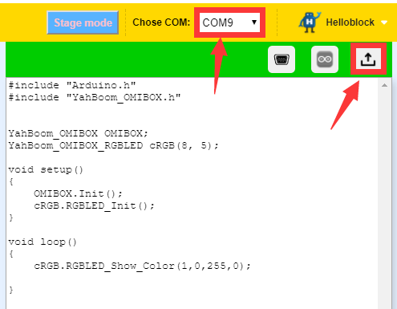
11.We need to go back to the programming interface, select the CH340 port number identified in the previous step in the upper right corner (here is COM9), then click the up arrow to start compiling and uploading the program.
Yahboom OMIBOX Tutorial

Slide 13
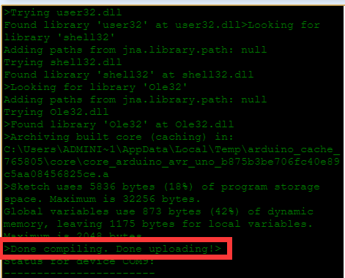
12.Uploading the program takes some time. When the words "Done compiling Done uploading" appear in the lower right corner of the programming interface, as shown in the following figure, the program has been uploaded.
!!!Note:During the upload process, you must turn on the power switch of the OmiBox robot during
Yahboom OMIBOX Tutorial

Slide 14
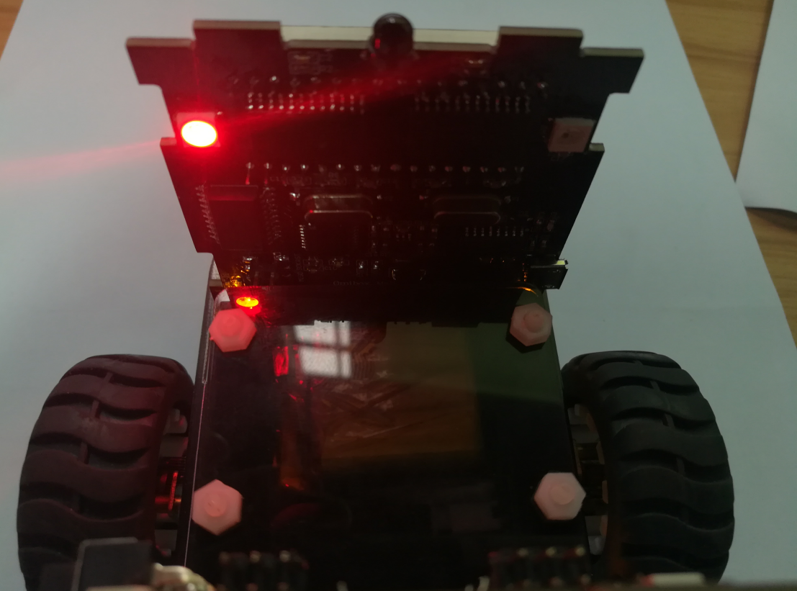
13.After the program upload is complete, we can see the experimental phenomenon: the 0th light of the OmiBox robot lights up red, as shown in the figure below.
Yahboom OMIBOX Tutorial

Slide 15
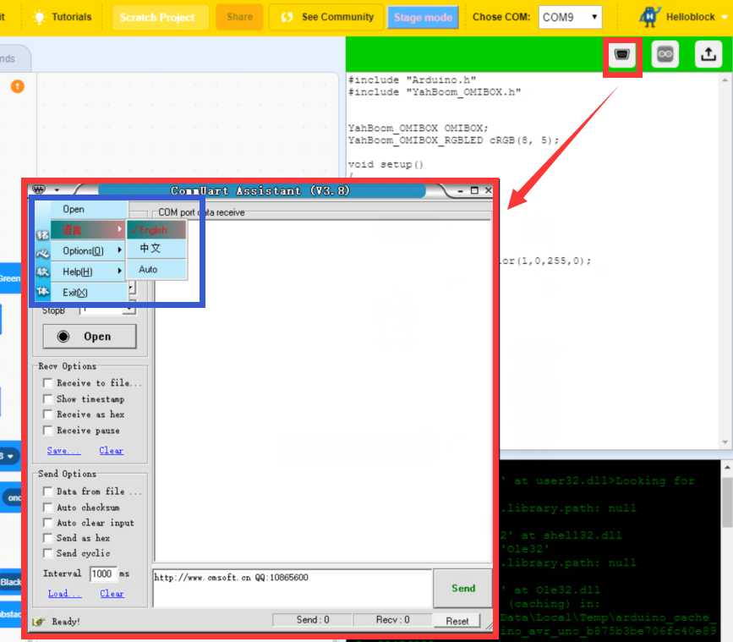
14.In the 【Code Mode】 interface, we can click on the place as shown below to open the serial port. We can change the language.
Yahboom OMIBOX Tutorial

Slide 16
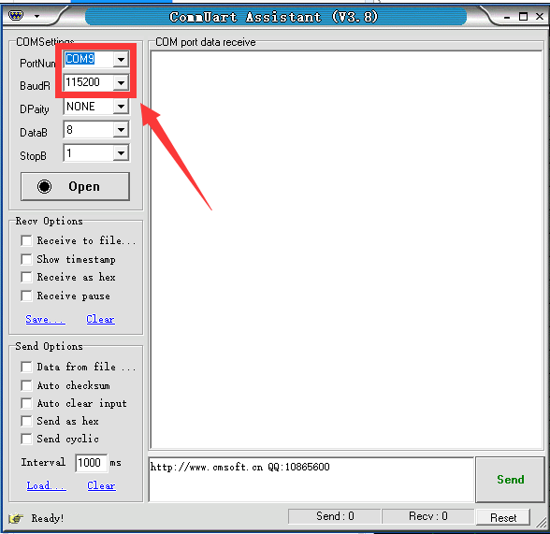
15.The serial port number needs to be the same as our programming interface. The default baud rate is 115200.
Yahboom OMIBOX Tutorial

Slide 17
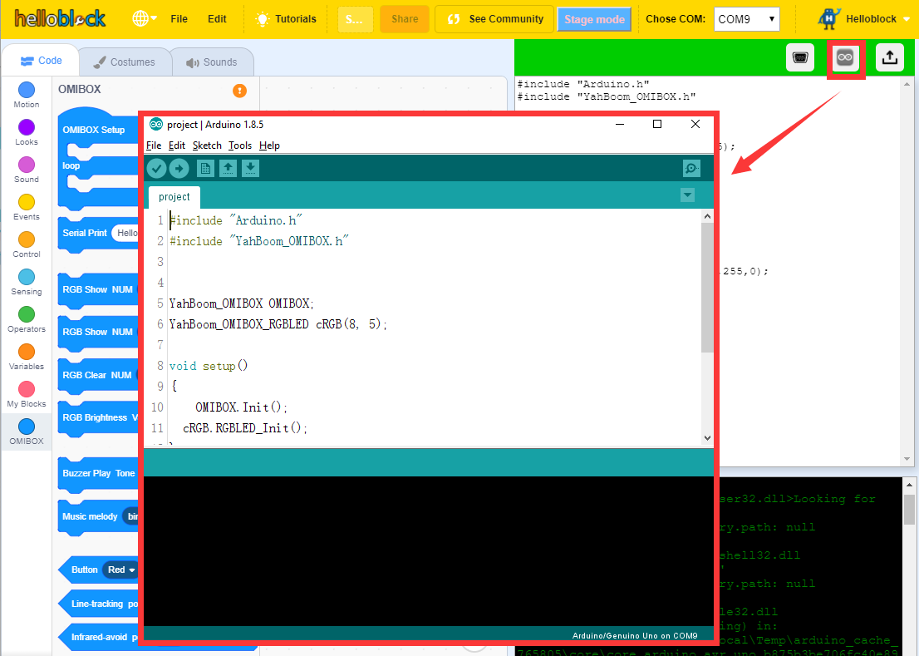
16.In the [Code Mode] interface, we can click on the place shown below to open the Arduino IDE programming interface.
Yahboom OMIBOX Tutorial

Slide 18
Inspire Creativity Embrace Innovation
Thank you!!!
Yahboom

